Slide 1
SIH25017_ Digital Platform for Centralized Alumni Data Management and Engagement
Final Year Project - 2026
Review-೨
Batch Number: CSE_201
Roll Number | Student Name
20221CSE0412 | SIDDHARDHA VARMA
20221CSE0556 | SRINATH K S
20221CSE0402 | RITEESH
Under the Supervision of :
Ms . Rajitha Reddy
Assistant Professor
School of Computer Science and Engineering
Presidency University
Name of the Program: B . TECH
Name of the HoD: Dr. Asif Mohamed HB
Name of the Program Project Coordinator: Dr.Jayavadivel R
Name of the School Project Coordinators: Dr. Sampath A K , Dr. Geetha A

Slide 2
CONTENT:
ABSTRACT
LITERATURE SURVEY
OBJECTIVES
METHODOLOGY
Existing Methods and Drawbacks
Proposed Methods and feasibility study
Architecture diagram
Modules
Hardware and Software details
Timeline
Reference

Slide 3
ABSTRACT
The rapid growth of higher education institutions has resulted in a large volume of alumni data that is often scattered, outdated, and poorly managed. Most existing alumni systems focus only on basic data storage and lack advanced engagement, analytics, and centralized management features. This project proposes a Centralized Alumni Data Management and Engagement System that provides a unified digital platform for storing, managing, and analyzing alumni academic and professional information. The system enables structured alumni–student interaction, mentorship programs, job referrals, and institutional engagement activities. Additionally, the platform offers administrative monitoring and analytics tools to support data-driven decision making. The proposed solution aims to improve alumni connectivity, institutional development, and long-term graduate tracking in a secure and scalable manner.

Slide 4
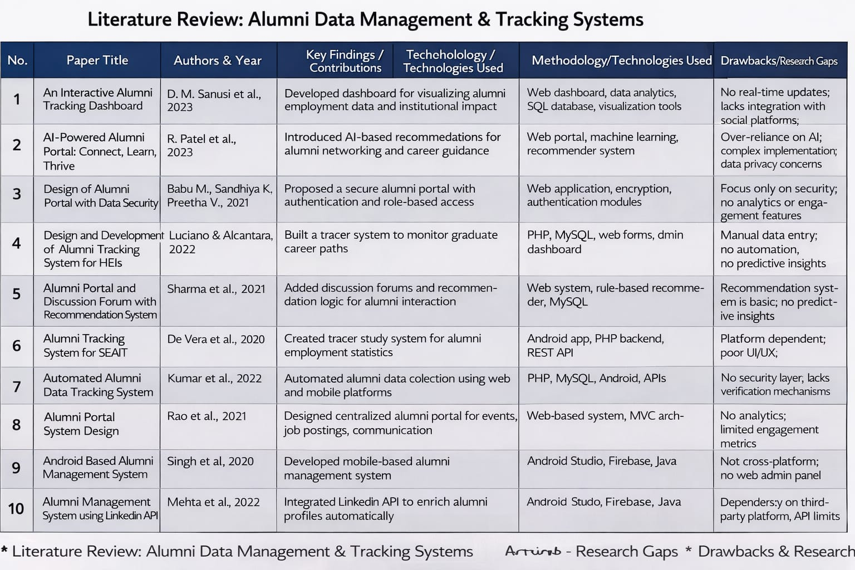
Literature survey

Slide 5
OBJECTIVES:
To develop a centralized and secure alumni data management system
To create a unified digital repository for storing, updating, and managing alumni academic and professional information.
To enable structured alumni–student interaction and mentorship
To provide a digital platform where students can connect with alumni for mentorship, career guidance, and professional networking.
To support job referrals and institutional engagement activities
To allow alumni to post job opportunities, manage event participation, and contribute to institutional development.
To provide administrators with monitoring and analytics tools
To help institutions analyze alumni trends, engagement levels, placement statistics, and system usage patterns.

Slide 6
METHODOLOGY
Requirement Analysis and Problem Identification
System Architecture Design
Database Design and Centralized Repository Creation
Module Development
Security Implementation
Analytics and Monitoring Implementation
Testing and Validation
Deployment and System Evaluation

Slide 7
Existing Methods and Drawbacks
Existing Methods:
Manual alumni record maintenance using spreadsheets.
Static alumni portals with limited interaction.
Mobile-based alumni applications without analytics.
Independent systems for events, jobs, and communication.
Drawbacks:
No centralized data repository.
Outdated and inconsistent data.
Lack of real-time engagement.
Weak security and privacy mechanisms.
No analytics for decision making.
No job referral tracking.
Platform dependency.
Poor scalability.

Slide 8
Proposed Method & Feasibility Study
Proposed Method:
The proposed system introduces a web-based centralized alumni management platform with modular architecture. It integrates alumni data management, mentorship, job referrals, engagement activities, and analytics into a single system.
Key Features:
Centralized alumni database.
Secure role-based login.
Mentorship request system.
Job posting and event management.
Analytics dashboards.
Feasibility Study
Technical Feasibility:
Uses standard web technologies (HTML, CSS, JS, PHP/Node, MySQL) which are easily implementable.
Economic Feasibility:
Uses open-source tools, so cost is minimal.
Operational Feasibility:
User-friendly interfaces for alumni, students, and admins.
Resource Feasibility:
Can be developed by a small student team with basic hardware.

Slide 9
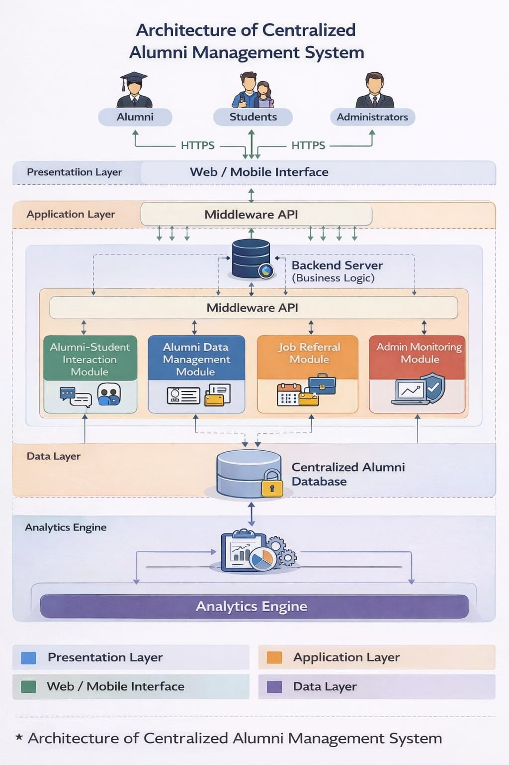
ARCHITECTURE DIAGRAM

Slide 10
Modules
1. User Authentication Module
Login / Registration
Role-based access
2. Alumni Data Management Module
Profile creation
Academic & professional info
3. Mentorship Module
Request system
Communication
4. Job Referral Module
Job posting
Applications
5. Engagement Module
Events
Participation tracking
6. Analytics Module
Graphs
Reports
7. Admin Module
User control
System monitoring

Slide 11
Hardware and Software Details
Hardware:
Processor: Intel i3 or above
RAM: 4 GB minimum
Storage: 50 GB
Internet connection
Software:
Frontend: HTML, CSS, JavaScript, Bootstrap
Backend: PHP / Node.js
Database: MySQL
Server: XAMPP / Localhost
OS: Windows / Linux

Slide 12
Timeline of the Project (Gantt Chart)
● Jan 13 2026 (Review-1): Project planning, finalization of objectives, and comprehensive literature review.
● Feb 3-27 2026 (Review-2 & 3): Dataset collection, ML model development, and integration into the web application.
● March 28 2026 (Review-4): AI voice assistant integration, rigorous testing, and refinement based on feedback.
● April 2026 (Final Viva): Final deployment of the platform, documentation, and final demonstration.

Slide 13
References:
[1] D. M. Sanusi et al., “An Interactive Alumni Tracking Dashboard,” in Proc. IEEE Conf. on Educational Technologies, 2023.
[2] Babu M., Sandhiya K., Preetha V., “Design of Alumni Portal with Data Security,” IEEE ICESC, 2021.
[3] Luciano & Alcantara, “Design and Development of Alumni Tracking System for HEIs,” IEEE, 2022.

Slide 14


